Slide 1


Re-registering your incorporated society under the new Act
Robert Clarke, MBIE
July 2022

Slide 2
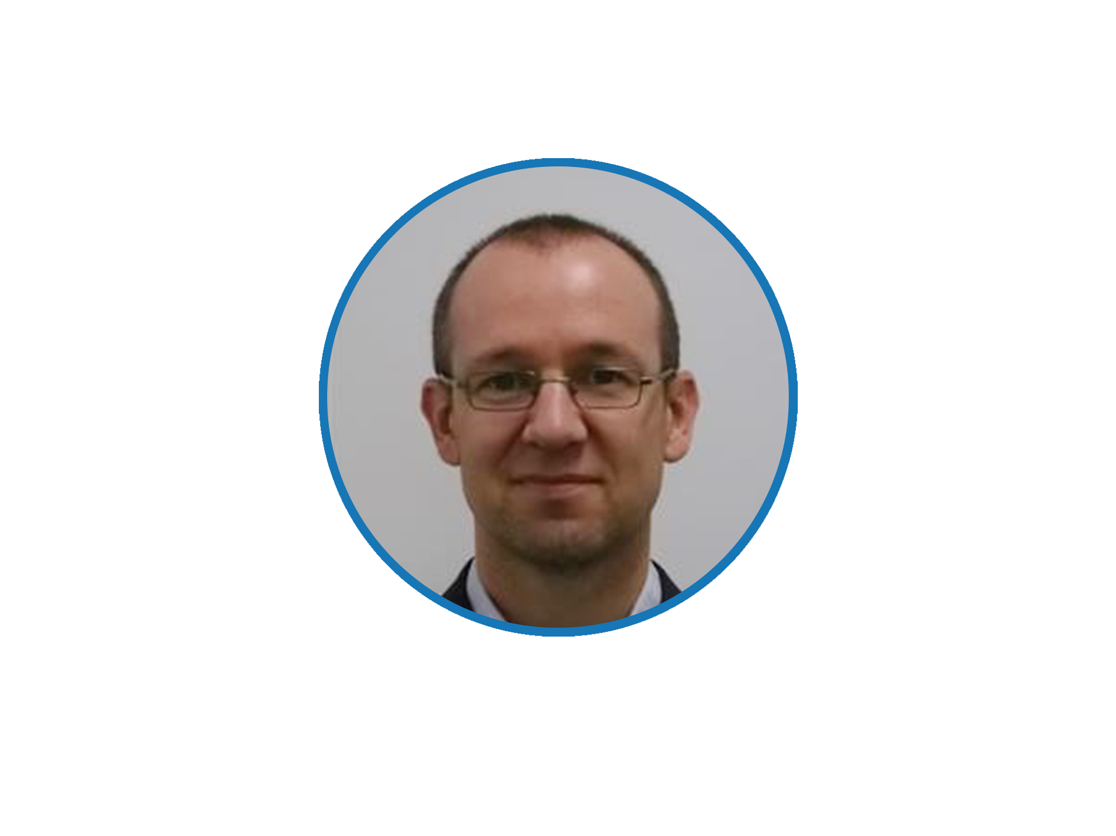



Welcome
Francesca Ephraim
Regional Capability Advisor
Charities Services
Robert Clarke
Senior Policy Advisor
MBIE

Slide 3
Logistics
Can you hear us?
Make sure your computer’s sound is un-muted.
Sound cutting out? Check your internet connection.
Recording
This webinar is being recorded - you will receive a link to the recording via email.
Q&A
Type your questions in the Q&A chat box.
If your question doesn’t get answered during the webinar, we have your email and will get back to you
Connectivity issues
In the event that we experience connectivity issues and are unable to present, we will contact you with further information.

Slide 4
The last presentation…
assumed you would re-register under the new Incorporated Societies Act
explained what your obligations would be under the new Incorporated Societies Act
You can watch it be searching webinars on the Charities Services website

Slide 5
This presentation…
concerns the re-registration process available between early October 2023 and early April 2026
is aimed at helping you decide whether to re-register and, if so, when

Slide 6
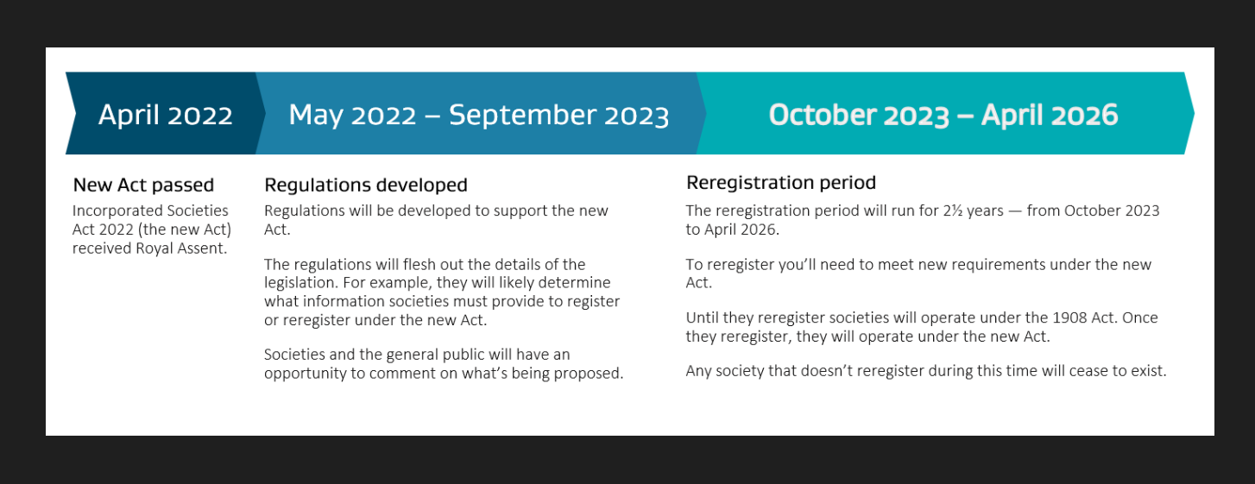
Timeline

Slide 7
You will need…
a new constitution with:
  dispute resolution rules
  a suitable wind up clause
  and at least 10 members

Slide 8
What will the re-registration process involve?
online
fill in form
upload constitution
  dispute resolution rules
  not-for-profit beneficiary
await confirmation of re-registration
re-registration fee?

Slide 9
Application essentials
Your application needs:
  to name at least 10 members
  a society name that is acceptable
  a purpose that is acceptable
  a constitution that meets the requirements of the Act

Slide 10
What happens if your application is rejected or you choose not to re-register?
your society will cease to exist
it will need to pay all its debts
anything left over will need to be distributed as per the constitution

Slide 11
Please re-register early
the period for re-registration is October 2023 to early April 2026
24,000 incorporated societies
reasons to re-register early:
  In case your first attempt is rejected
  Gives you time to re-apply

Slide 12
Have your say
Spring 2022: consultation on regulations
engage@societies.govt.nz

Slide 13
Other important things to note
  there is no rush to do anything now
  new constitution will be required
  there will be help available
  incorporated societies that are registered charities will still use the NFP reporting standards

Slide 14
End
Questions
???

Slide 15
Resources
  Update on law changes for incorporated societies
  Resource hub – ParryField Lawyers
  5 things you need to know about the new Incorporated Societies Act
  Resource sheet

Slide 16
End
Thank you
Ngā mihi nui ki a koutou!
Notes:
Francesca
We’ve come to the end of the webinar so I just want to say….
Thank you for attending today and for the work you do in your communities.
We will be working with MBIE to provide you with more information as needed so please sign up to our newsletter on the home page of our website so you receive it.
The recording of this webinar will be up on our website by next week if you want to share it with your people.
Thanks again
Have a great afternoon.
Ka kite ano.

